Slide 1
Dental classification

Slide 2
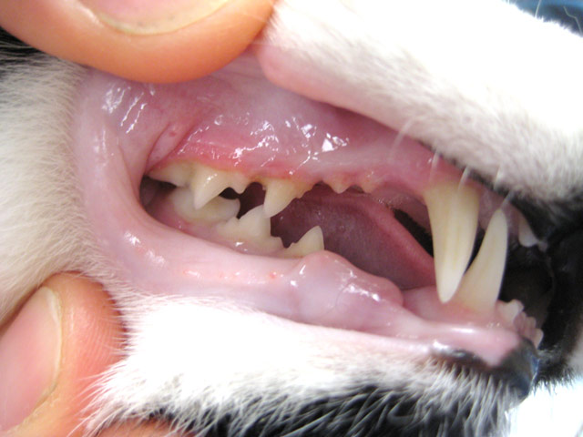
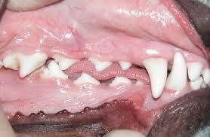
Grade 0
No plaque or gingivitis. Young healthy dogs and cats 6-12 months.

Slide 3
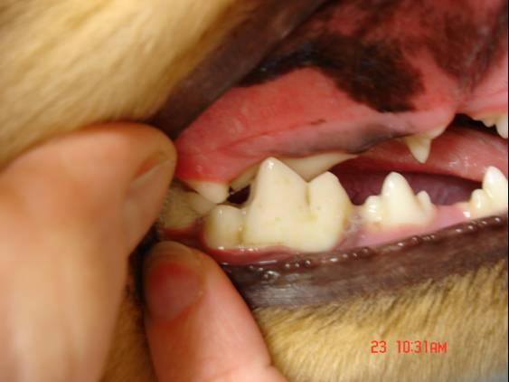
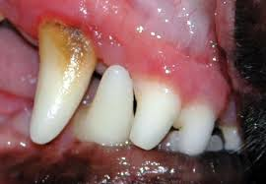
Grade 1
Plaque formation on some teeth mainly premolars and molars. Mild gingivitis along gum line. No evidence of infection.

Slide 4
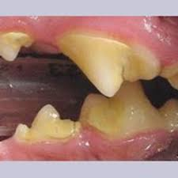
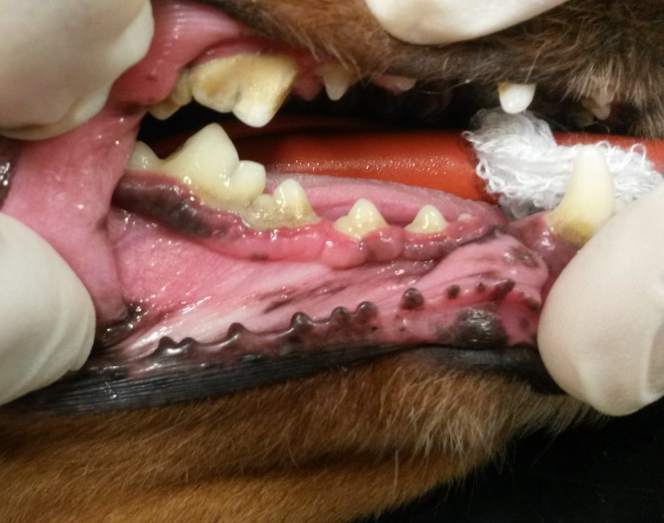
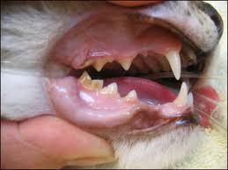
Grade 2
Evidence of mild to moderate tartar (mineralised plaque) affecting most teeth. Moderate gingivitis. No evidence of infection.

Slide 5
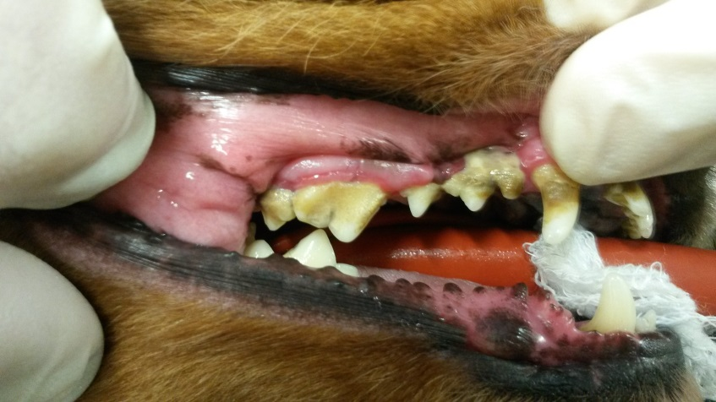
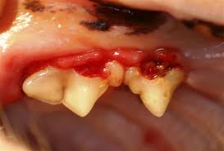
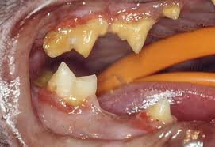
Grade 3
Significant tartar. Gingivitis and oedema of the gum margin. Infection. Halitosis. Some oral pain. At least 2 teeth require extraction. Some loose or fractured teeth. 2 or more teeth with obvious neck lesions (FORLs).

Slide 6
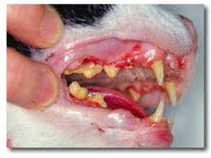
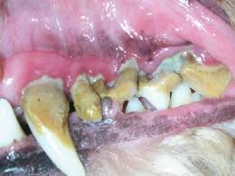
Grade 4
Overt peri-dontal disease (gum recession, tooth roots visible). Marked pain and halitosis. Inappetence. Multiple loose teeth. Multiple extractions required. Reluctance to open mouth.

Slide 7
Grading scale
Grade | Description | Action
0 | No plaque or gingivitis. Young healthy dogs 6-12 months | Nothing
1 | Plaque formation on some teeth mainly premolars and molars. Mild gingivitis along gum line. No evidence of infection. | Dogs- may be reversed by brushing, dental chews, plaque off. Cats suggest dental diet.
2 | Evidence of mild to mod tartar (mineralised plaque) affecting most teeth. Moderate gingivitis. No evidence of infection | As above, re assess all cases within 6 months. Consider scale and polish in patients where cleaning not practical
3 | Significant tartar. Gingivitis and oedema of gum margin. Infection. Halitosis. Some oral pain. At least 2 teeth may need extraction. Some loose or fractured teeth. 2 or more teeth with obvious neck lesions. (FORLS). | Dental extractions required with antibiotics.
4 | Overt peri-dontal disease (gum recession, tooth roots visible.) Marked pain and halitosis. Inapetence. Multiple loose teeth. Multiple extractions required. Reluctance to open mouth. | Dental extractions required urgently with antibiotics (+/- IVFT)

